Slide 1
LWC Training
Work with
Salesforce Data
MAY 7, 2019
Day 2 : Work with Salesforce Data

Slide 2
Day 2 Training
agenda
Creating a Form
Working with Wire adapters
Hands on Challenge

Slide 3
Lightning Data Service
Technical design
To work with data and metadata for Salesforce records, use components, wire adapters, and JavaScript functions built on top of Lightning Data Service (LDS) and UI API.
Records loaded in Lightning Data Service are cached and shared across components.
If a page is composed of components showing the same record, all components show the same version of the record.
Components accessing the same record see significant performance improvements, because a record is loaded once, no matter how many components are using it.
Lightning Data Service does a lot of work to make code perform, such as:
Loads record data progressively.
Caches results on the client.
Invalidates cache entries when dependent Salesforce data and metadata changes.
Optimizes server calls by bulkifying and deduping requests.

Slide 4
How LDS works?
Technical design
Lightning Data Service is built on top of User Interface API. UI API is a public Salesforce API that Salesforce uses to build Lightning Experience and Salesforce for iOS and Android
UI API gives you data and metadata in a single response. Responses match layout changes
UI API responses also respect CRUD access, FLS and sharing settings
Creating a Form to Work with Records
How to get all these features ?
Import lightning/ui*Api module in your js file

Slide 5
Ways of interacting with Salesforce Data
Technical design
Creating a Form to work with Records
Using the Base Lightning components built on LDS, without requiring Apex code :
lightning-record-form (Supports edit, view, and read-only modes)
lightning-record-edit-form (Displays an editable form)
lightning-record-view-form (Displays a read-only form)
@wire adapters –
JavaScript UI APIs/ Apex Methods
If you need more customization, use @wire to specify a Lightning Data Service wire adapter.
Three Ways using @wire adapters for UI-APIs:
as a property (i.e. as variable)
as a function
Imperative Approach

Slide 6
Creating a Form to Work with Records

Slide 7
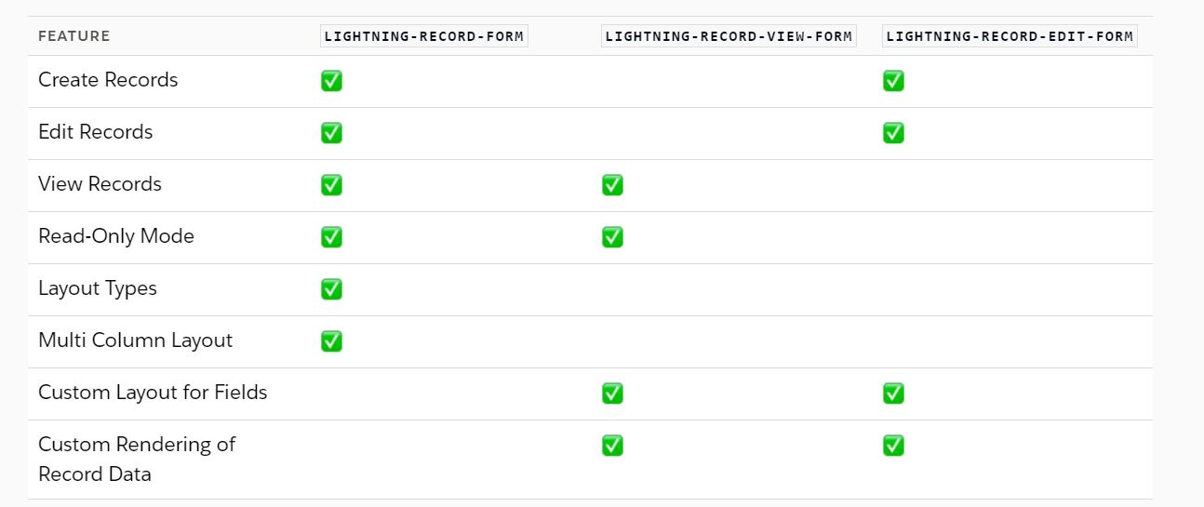
Technical design
Creating a Form to Work with Records
These components provide a form layout and handle record create, read, and update changes without requiring Apex code. They use Lightning Data Service to cache and share record updates across components.
This is simplest, easiest approach to interact with Salesforce.
Creating a Form to Work with Records
Creating a Form to Work with Records

Slide 8
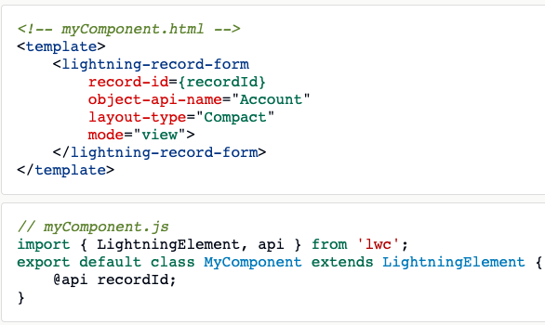
Technical design
Creating a Form to Work with Records
Example : Read-Only Account Form -
Creating a Form to Work with Records
Creating a Form to Work with Records
More Examples of Create New Record, Edit Record form , custom edit form layout variants can be found Here

Slide 9
Hands on Challenge

Slide 10
Technical design
Use Case
Create an LWC component for record detail page showing Account name, Owner, Address and Type fields in Edit mode as well as just View mode.
Creating a Form to Work with Records
Creating a Form to Work with Records

Slide 11
Wire Adapter

Slide 12
Technical design
Get Data with Wire Service
HTML
<template>
{record}
</template>
Syntax
Import {adapterId} from ‘adapterModule’;
@wire(adapterId, adapterConfig) propertyFunction;
Creating a Form to Work with Records
Creating a Form to Work with Records
Import { LightningElement, api, wire } from 'lwc’;
import { getRecord } from 'lightning/uiRecordApi’;
export default class Record extends LightningElement {
@api recordId;
@wire(getRecord, { recordId: '$recordId', fields: ['Account.Name'] }) record;
}

Slide 13
Technical design
Using @wire to specify a Lightning Data Service wire adapter
The wire service delegates control flow across Lightning Web Components.
To use standard JavaScript functions for CRUD operations, import respective functions from the lightning/uiRecordApi module.
Eg:
import { getRecord, getFieldValue, updateRecord, createRecord, deleteRecord}
from 'lightning/uiRecordApi’;
To use Apex method in JS, we need to import the @AuraEnabled method from Apex class:
Eg: import getContact from '@salesforce/apex/ContactController.getContact';
Creating a Form to Work with Records
Creating a Form to Work with Records

Slide 14
Technical design
Calling Apex Methods
Import Apex Methods
Annotate Apex method with
@AuraEnabled(cacheable=true)
Function in Javascript
Creating a Form to Work with Records
Creating a Form to Work with Records
Call Function
Wire Service
Call Imperatively
Wire apex method to a property
Wire apex method to a function

Slide 15
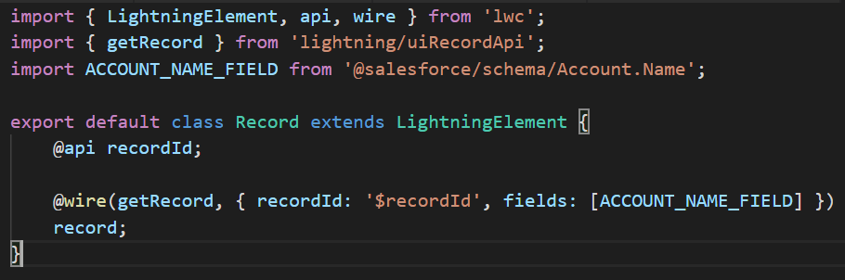
Technical design
3 Ways using @wire adapters for UI-APIs
1. As a Property (i.e., variable):
First, the code imports the getRecord wire adapter from the lightning/uiRecordApi module, which is built on LDS. Then it defines the fields to pass to the wire adapter.
The component uses @api to define a public recordId property. If the component is nested in a Lightning record page, which our component is, the Lightning page sets the value of recordId.
The @wire decorator tells getRecord to get the values of the specified fields on the record with the specified $recordId. The $ means that the value is passed dynamically. When the value changes, the wire service provisions data and the component rerenders.
The data is provisioned to the data and error objects of the property decorated with @wire. In this example, that’s the ”record” property.
“getRecord” method is wired to the “record” property
$recordId is dynamic and reactive
Fields can be given in a string like “[‘Account.Name’]” or we can pass Array of fields

Slide 16
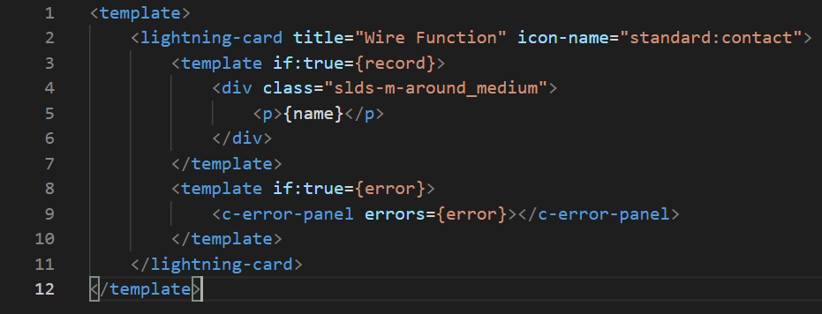
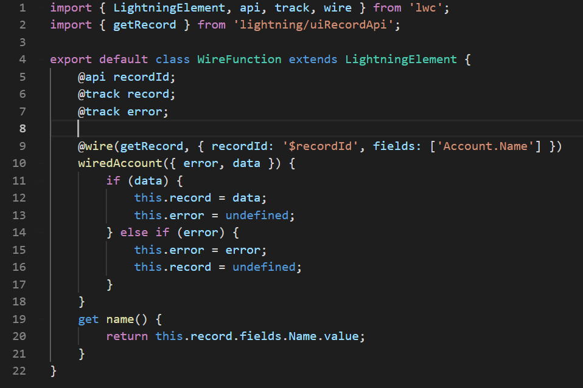
Technical design
3 Ways using @wire adapters for UI-APIs
2. As a Function
Creating a Form to Work with Records
Creating a Form to Work with Records
Wiring a function is useful to perform logic whenever new data is provided or when an error occurs. The wire service provisions the function an object with error and data properties, just like a wired property.

Slide 17
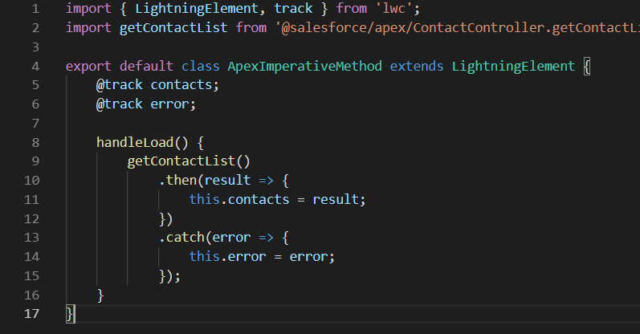
Technical design
3 Ways using @wire adapters for UI-APIs
3. Call Apex using Imperative Approach
To call an Apex method, LWC can:
Wire a property
Wire a function
Call a method imperatively
Detailed Examples can be found here
https://developer.salesforce.com/docs/component-library/documentation/lwc/lwc.apex
Creating a Form to Work with Records
Creating a Form to Work with Records

Slide 18
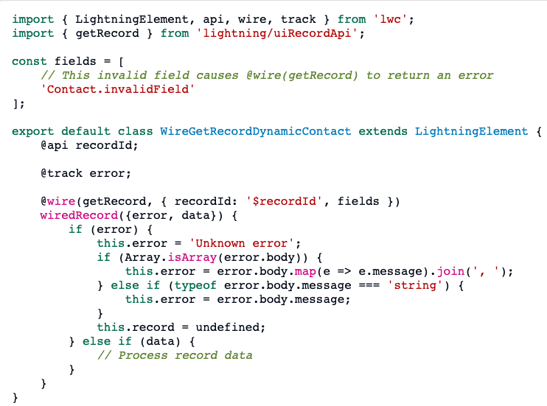
Technical design
Handle Errors in Lightning Data Service
Lightning Data Service returns an error when a resource, such as a record or an object, is inaccessible on the server.
Error Values:
body (Object or Array) - The body of the response, which is defined by the underlying API.
ok (Boolean) - Specifies whether the response was successful or not. For an error, ok is always false and contains a status in the range 400–599.
status (Number) - Contains the status code of the response, for example, 404 if a resource is not found or 500 for an internal server error.
statusText (String) - Contains the status message corresponding to the status code, for example, NOT_FOUND for a status code of 404.
Creating a Form to Work with Records
Creating a Form to Work with Records

Slide 19
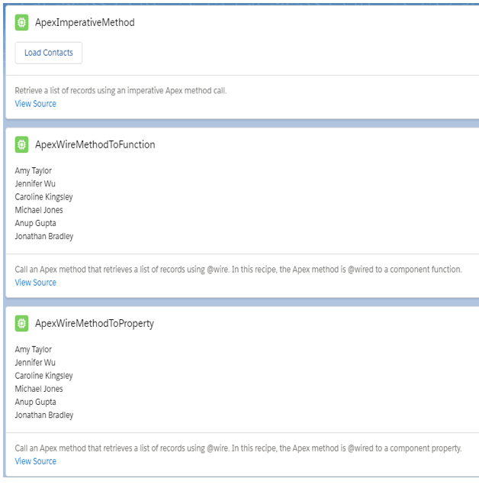
Technical design
Sample Components
Use LWC-recipes apexWireMethodToFunction, apexWireMethodToProperty, apexImperativeMethod components to explain.
LWC Recipes Github Repo Detailed Examples can be found here :
Creating a Form to Work with Records
Creating a Form to Work with Records

Slide 20
Technical design
Points to remember
We have to use @AuraEnabled in apex method to expose it to LWC, and cacheable= true to enables function to be called using wire service(as Records loaded using @wire are cached in LDS.
Apex Methods should be declared as public/global with static keyword. Eg:
@AuraEnabled(cacheable=true)
public static List<Contact> getContactList() {
//Write you code
}
Leading decorators- @wire adapters can be used only on class level. Hence we go for Imperative approach for using leading wire decorators at JS- functional level.
If you’re using a wire adapter in the lightning/ui*Api modules, Salesforce strongly recommends importing references to objects and fields.
To import objects, we use the naming convention OBJECTNAME_OBJECT.
For fields, we use the naming convention FIELDNAME_FIELD, these are guidelines for readable code not rules.
Creating a Form to Work with Records
Creating a Form to Work with Records

Slide 21
Questions

Slide 22
1.what are the base Lightning components to work with data in LWC.
lightning-record-form
lightning-record-edit-form
lightning-record-view-form
all of the above
2.where can be @wire property can be used in LWC
If Lightning Data Service detects a change to a record or any data or metadata it supports, then all components using a relevant the new value.
when you need more customization than those components allow
none
All of the above.
3.what is the annotation to exposes the method to Lightning components and caches the list of contacts on the client.
@AuraEnabled(cacheable=true)
@AuraEnabled
A and b
none of the above

Slide 23
Hands on Challenge

Slide 24
Technical design
Use Case
Get the latest ten contact records on a button click and display them using lightning data table.
Create a contact creation for using record-form component. Create another component which shows latest records, make sure that the component showing list of recent records refreshes on its own when you create new record through the first component.
Creating a Form to Work with Records
Creating a Form to Work with Records

